Slide 1
Software Design and Architecture
Lecture-5

Slide 2
Low Coupling

Slide 3
Coupling
Coupling is a measure of how strongly one element is connected to, has knowledge of, or depends on other elements.
If there is coupling or dependency, then when the depended-upon element changes, the dependant may be affected.
Low Coupling is a desirable property of design because:
  Changes in related classes force local changes.
  Harder to understand in isolation; need to understand other classes.
  Harder to reuse because it requires additional presence of other classes.

Slide 4
Low Coupling Pattern
Name: | Low Coupling
Problem: | How to reduce the impact of change?
Solution: (advice) | Assign responsibilities so that (unnecessary) coupling remains low. Use this principle to evaluate alternatives.

Slide 5
Coupling in OO languages
TypeX has an attribute that refers to a TypeY instance, or TypeY itself.
A TypeX object calls on services of a TypeY object.
TypeX has a method that references an instance of TypeY, or TypeY itself, by any means. These typically include a parameter or local variable of type TypeY, or the object returned from a message being an instance of TypeY.
TypeX is a direct or indirect subclass of TypeY.
TypeY is an interface, and TypeX implements that interface.

Slide 6
Common Forms of Coupling
Low Coupling is an evaluative principle that is applied while evaluating design decisions.
Common forms of coupling from TypeX to TypeY include:
  TypeX has an attribute that refers to a TypeY object.
      class Car {
      private Person owner;
      …
      }
  A TypeX object calls on services of a TypeY object.
      class Application {
      public void start() {
      (new Game()).initialize();
      }
      }

Slide 7
  TypeX has a method that references a TypeY object. For example, as a parameter or local variable or the object returned from a message sent to a TypeY object.
      class Game {
      …
      public void addPlayer(Person p) {
      …
      }
      }
  TypeX is a direct or indirect subclass of TypeY.
      class MyApplet extends JApplet {
      …
      }

Slide 8
  TypeY is an interface, and TypeX implements that interface.
      class Game extends JApplet implements ActionListener {
      …
      }

Slide 9
Coupling
A subclass is strongly coupled to its superclass.
Consider carefully any decision to derive from a superclass since it is such a strong form of coupling.

Slide 10
Low Coupling
Low Coupling supports the design of classes that are more independent, which reduces the impact of change.
It can't be considered in isolation from other patterns such as Expert and High Cohesion,
Rather needs to be included as one of several design principles that influence a choice in assigning a responsibility.

Slide 11
A Practical Example
A good example of a system that has high cohesion and low coupling is the electric subsystem of a house. Because it is made out of a set of appliances with clearly definable function and interconnected with wires, the system has low coupling..

Slide 12
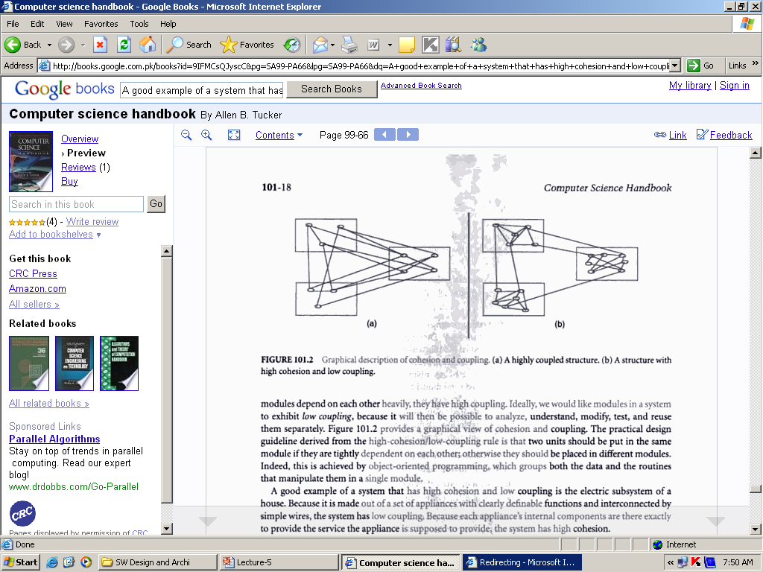
A Practical Example

Slide 13
Example
Assume we need to create a Payment instance and associate it with the Sale.
What class should be responsible for this?
By Creator, Register is a candidate.
Register coupled to payment.

Slide 14
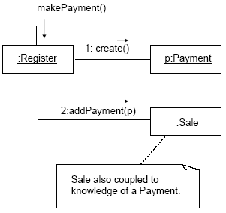

Slide 15
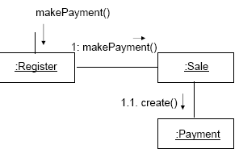
Alternate Solution
An alternative solution is to create Payment and associate it with the Sale.
No coupling between Register and Payment.

Slide 16
There is no specific measurement for coupling, but in general, classes that are generic and simple to reuse have low coupling.
There will always be some coupling among objects, otherwise, there would be no collaboration.

Slide 17
Composition vs. Inheritance
Composited (composed) objects are often referred to as having a "has a" relationship. A real-world example of composition may be seen in an automobile: the objects wheel, steering wheel, seat, gearbox and engine may have no functionality by themselves, but an object called automobile containing all of those objects would serve a higher function, greater than the sum of its parts
My object consists of other objects which in turn cannot exist after my object is destroyed-garbage collected. Lifetime of the part is controlled by the whole.

Slide 18
Composition
public class A
  {
  private B b = new B();
  public A()
  { }
  }

Slide 19
Inheritance
class Fruit
  { //...
  }
class Apple extends Fruit
  { //...
  }

Slide 20
High Cohesion

Slide 21
Cohesion
In software design, a basic quality known as cohesion informally measures how functional the operations of a software element are, and also measures how much work a software element is doing on its own, without depending much on others.
High Cohesion is a desirable property of good design.

Slide 22
High Cohesion Pattern
Name: | High Cohesion
Problem: | How to keep objects focused, understandable, and manageable, and as a side effect, support Low Coupling?
Solution: (advice) | Assign responsibilities so that cohesion remains high. Use this to evaluate alternatives.

Slide 23
Low cohesion – a problem
A class with low cohesion does many unrelated things or does too much work.
Such classes are undesirable; they suffer from the following problems:
  hard to comprehend
  hard to reuse
  hard to maintain
  delicate; constantly affected by change

Slide 24
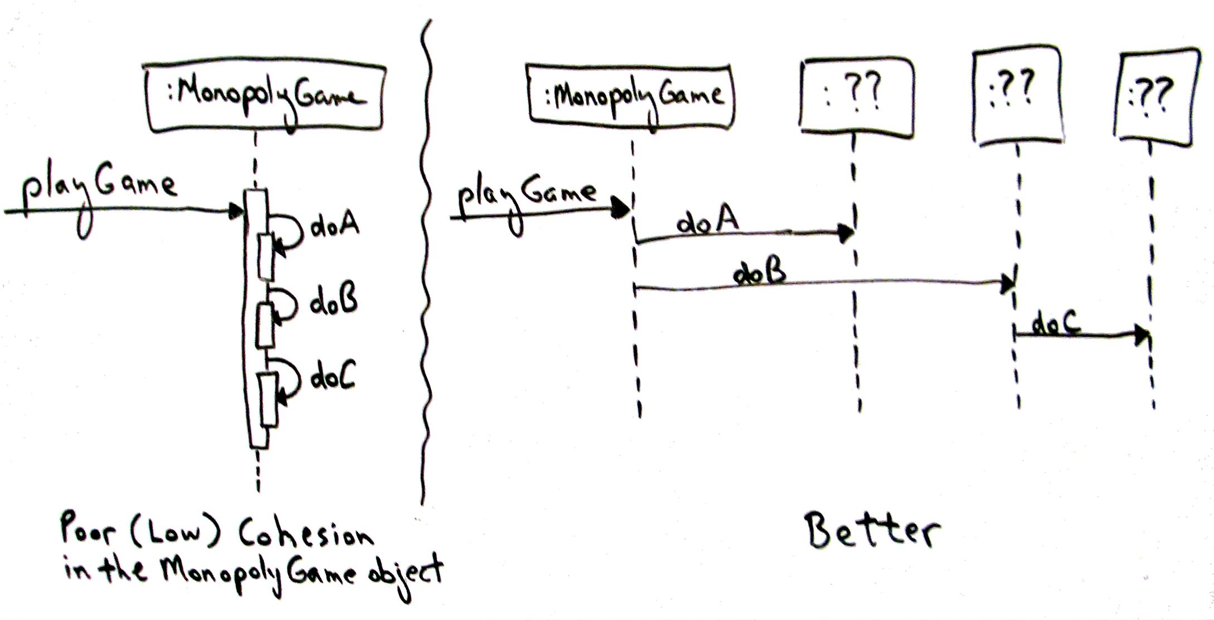

Slide 25
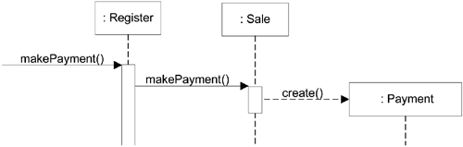
Example

